Slide 1
Chapter 16: Query Optimization

Slide 2
Outline
Introduction
Transformation of Relational Expressions
Catalog Information for Cost Estimation
Statistical Information for Cost Estimation
Cost-based optimization
Dynamic Programming for Choosing Evaluation Plans
Materialized views

Slide 3
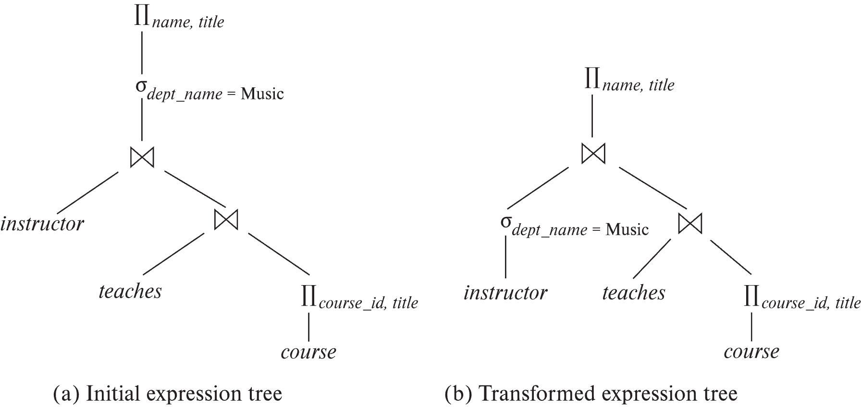
Introduction
Alternative ways of evaluating a given query
Equivalent expressions
Different algorithms for each operation

Slide 4
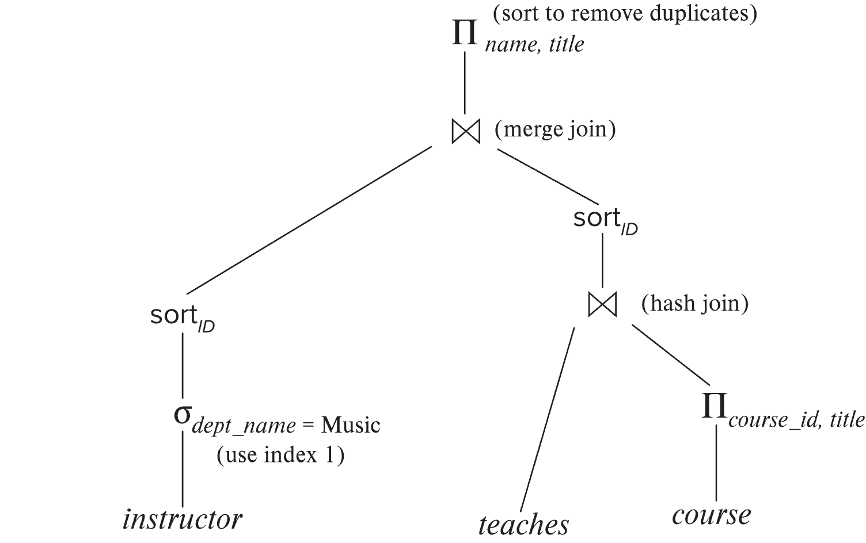
Introduction (Cont.)
An evaluation plan defines exactly what algorithm is used for each operation, and how the execution of the operations is coordinated.
Find out how to view query execution plans on your favorite database

Slide 5
Introduction (Cont.)
Cost difference between evaluation plans for a query can be enormous
E.g., seconds vs. days in some cases
Steps in cost-based query optimization
1. Generate logically equivalent expressions using equivalence rules
2. Annotate resultant expressions to get alternative query plans
3. Choose the cheapest plan based on estimated cost
Estimation of plan cost based on:
Statistical information about relations. Examples:
number of tuples, number of distinct values for an attribute
Statistics estimation for intermediate results
to compute cost of complex expressions
Cost formulae for algorithms, computed using statistics

Slide 6
Viewing Query Evaluation Plans
Most database support explain <query>
Displays plan chosen by query optimizer, along with cost estimates
Some syntax variations between databases
Oracle: explain plan for <query> followed by select * from table (dbms_xplan.display)
SQL Server: set showplan_text on
Some databases (e.g. PostgreSQL) support explain analyse <query>
Shows actual runtime statistics found by running the query, in addition to showing the plan
Some databases (e.g. PostgreSQL) show cost as f..l
f is the cost of delivering first tuple and l is cost of delivering all results

Slide 7
Generating Equivalent Expressions

Slide 8
Transformation of Relational Expressions
Two relational algebra expressions are said to be equivalent if the two expressions generate the same set of tuples on every legal database instance
Note: order of tuples is irrelevant
we don’t care if they generate different results on databases that violate integrity constraints
In SQL, inputs and outputs are multisets of tuples
Two expressions in the multiset version of the relational algebra are said to be equivalent if the two expressions generate the same multiset of tuples on every legal database instance.
An equivalence rule says that expressions of two forms are equivalent
Can replace expression of first form by second, or vice versa

Slide 9
Equivalence Rules
1. Conjunctive selection operations can be deconstructed into a sequence of individual selections. σ_{θ1 ∧ θ2} (E) ≡ σ_{θ1} (σ_{θ2} (E))
2. Selection operations are commutative. σ_{θ1}(σ_{θ2}(E)) ≡ σ_{θ2} (σ_{θ1}(E))
3. Only the last in a sequence of projection operations is needed, the others can be omitted. ∏ _{L1}(∏ _{L2}(…(∏ _{Ln}(E))…)) ≡ ∏ _{L1}(E) where L₁ ⊆ L₂ … ⊆ L_{n}
4. Selections can be combined with Cartesian products and theta joins.
σ_{θ} (E₁ x E₂) ≡ E₁ ⨝ _{θ} E₂
σ _{θ1} (E₁ ⨝_{θ2} E₂) ≡ E₁ ⨝ _{θ1∧θ2} E₂

Slide 10
Equivalence Rules (Cont.)
5. Theta-join operations (and natural joins) are commutative. E₁ ⨝ E₂ ≡ E₂ ⨝ E₁
6. (a) Natural join operations are associative:
(E₁ ⨝ E₂) ⨝ E₃ ≡ E₁ ⨝ (E₂ ⨝ E₃) (b) Theta joins are associative in the following manner: (E₁ ⨝ _{θ1} E₂) ⨝ _{θ2 ∧ θ3} E₃ ≡ E₁ ⨝_{θ1 ∧ θ3} (E₂ ⨝ _{θ2} E₃) where θ₂ involves attributes from only E₂ and E₃.

Slide 11
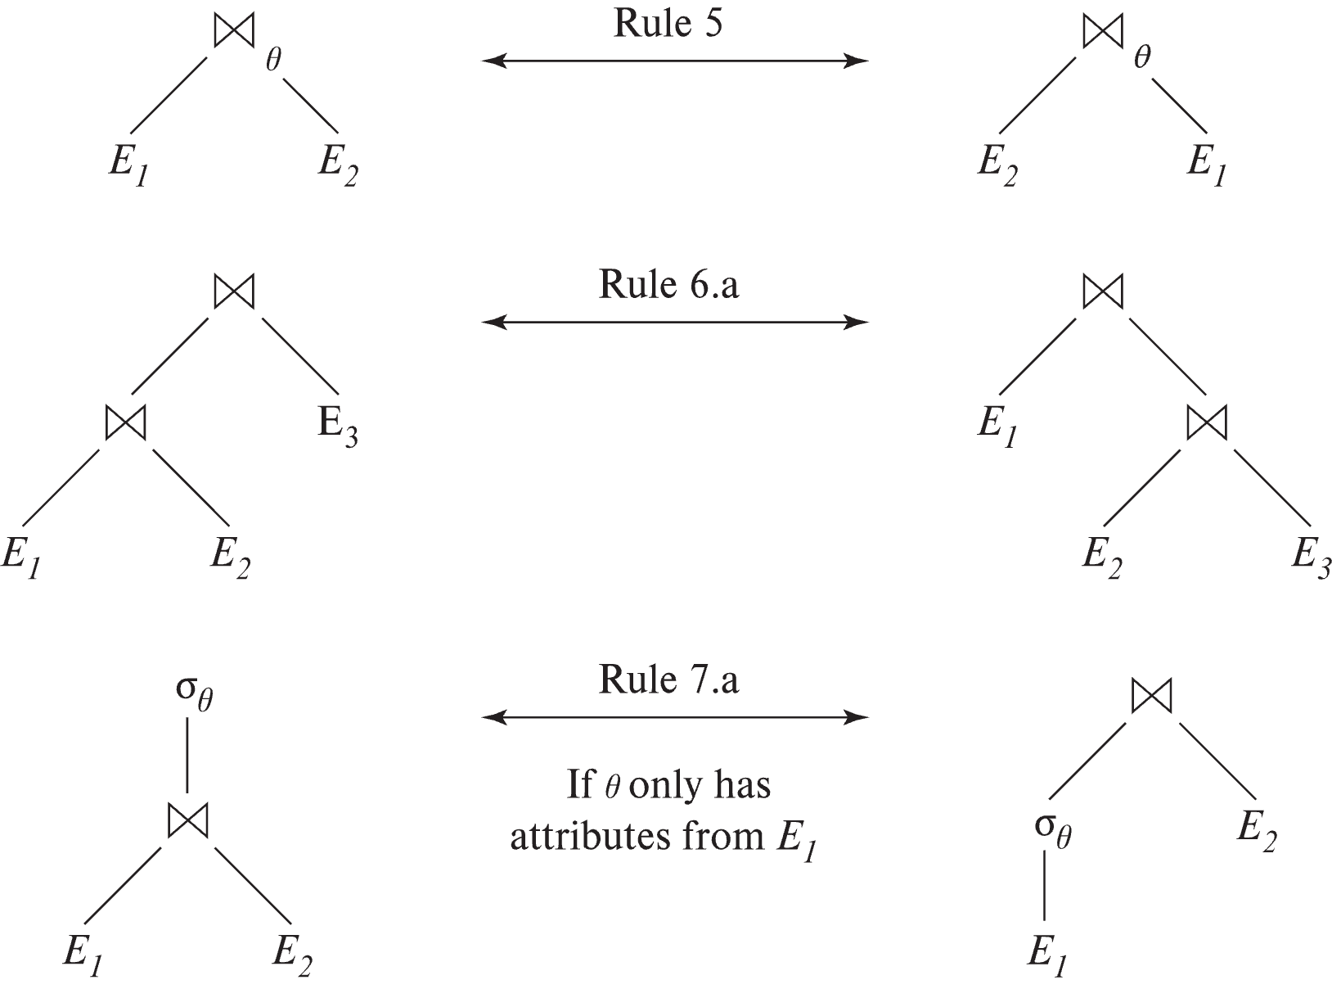
Pictorial Depiction of Equivalence Rules

Slide 12
Equivalence Rules (Cont.)
7. The selection operation distributes over the theta join operation under the following two conditions: (a) When all the attributes in θ₀ involve only the attributes of one of the expressions (E₁) being joined. σ_{θ0} (E₁ ⨝_{θ} E₂) ≡ (σ_{θ0}(E₁)) ⨝_{θ} E₂
(b) When θ₁ involves only the attributes of E₁ and θ₂ involves only the attributes of E₂.
σ_{θ1 ∧ θ2} (E₁ ⨝_{θ} E₂) ≡ (σ_{θ1}(E₁)) ⨝_{θ} (σ_{θ2}(E₂))

Slide 13
Equivalence Rules (Cont.)
8. The projection operation distributes over the theta join operation as follows:
(a) if θ involves only attributes from L₁ ∪ L₂: ∏ _{L1 ∪ L2}(E₁ ⨝_{θ} E₂) ≡ ∏ _{L1}(E₁) ⨝_{θ} ∏ _{L2}(E₂)
(b) In general, consider a join E₁ ⨝_{θ} E₂.
Let L₁ and L₂ be sets of attributes from E₁ and E₂, respectively.
Let L₃ be attributes of E₁ that are involved in join condition θ, but are not in L₁ ∪ L₂, and
let L₄ be attributes of E₂ that are involved in join condition θ, but are not in L₁ ∪ L₂. ∏ _{L1 ∪ L2}(E₁ ⨝_{θ} E₂) ≡ ∏ _{L1 ∪ L2}(∏ _{L1 ∪ L3}(E₁) ⨝_{θ} ∏ _{L2 ∪ L4}(E₂))
Similar equivalences hold for outerjoin operations: ⟕, ⟖, and ⟗

Slide 14
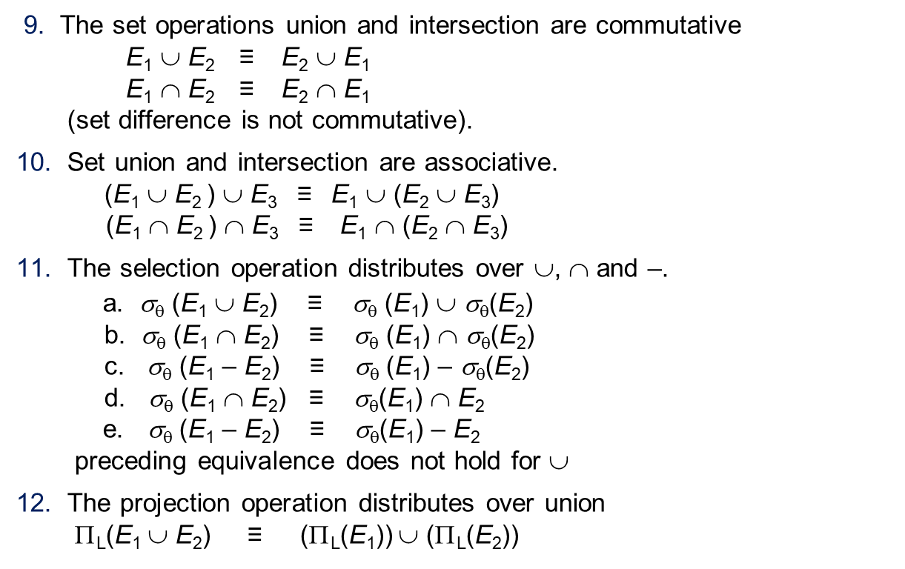
Equivalence Rules (Cont.)
9. The set operations union and intersection are commutative E₁ ∪ E₂ ≡ E₂ ∪ E₁ E₁ ∩ E₂ ≡ E₂ ∩ E₁ (set difference is not commutative).
10. Set union and intersection are associative. (E₁ ∪ E₂ ) ∪ E₃ ≡ E₁ ∪ (E₂ ∪ E₃) (E₁ ∩ E₂ ) ∩ E₃ ≡ E₁ ∩ (E₂ ∩ E₃)
11. The selection operation distributes over ∪, ∩ and –. a. σ_{θ} (E₁ ∪ E₂) ≡ σ_{θ} (E₁) ∪ σ_{θ}(E₂) b. σ_{θ} (E₁ ∩ E₂) ≡ σ_{θ} (E₁) ∩ σ_{θ}(E₂) c. σ_{θ} (E₁ – E₂) ≡ σ_{θ} (E₁) – σ_{θ}(E₂) d. σ_{θ} (E₁ ∩ E₂) ≡ σ_{θ}(E₁) ∩ E₂ e. σ_{θ} (E₁ – E₂) ≡ σ_{θ}(E₁) – E₂ preceding equivalence does not hold for ∪
12. The projection operation distributes over union Π_{L}(E₁ ∪ E₂) ≡ (Π_{L}(E₁)) ∪ (Π_{L}(E₂))

Slide 15
Equivalence Rules (Cont.)
13. Selection distributes over aggregation as below σ_{θ}(_{G}𝛾_{A}(E)) ≡ _{G}𝛾_{A}(σ_{θ}(E)) provided θ only involves attributes in G
14. a. Full outerjoin is commutative: E₁ ⟗ E₂ ≡ E₂ ⟗ E₁ b. Left and right outerjoin are not commutative, but: E₁ ⟕ E₂ ≡ E₂ ⟖ E₁
15. Selection distributes over left and right outerjoins as below, provided θ₁
only involves attributes of E₁ a. σ_{θ1} (E₁ ⟕_{θ} E₂) ≡ (σ_{θ1} (E₁)) ⟕_{θ} E₂ b. σ_{θ1} (E₁ ⟖_{θ} E₂) ≡ E₂ ⟕_{θ} (σ_{θ1} (E₁))
16. Outerjoins can be replaced by inner joins under some conditions
a. σ_{θ1} (E₁ ⟕_{θ} E₂) ≡ σ_{θ1} (E₁ ⨝_{θ} E₂) b. σ_{θ1} (E₁ ⟖_{θ} E₁) ≡ σ_{θ1} (E₁ ⨝_{θ} E₂) provided θ₁ is null rejecting on E₂

Slide 16
Equivalence Rules (Cont.)
Note that several equivalences that hold for joins do not hold for outerjoins
σ_{year=2017}(instructor ⟕ teaches) ≢ σ_{year=2017}(instructor ⨝ teaches)
Outerjoins are not associative (r ⟕ s) ⟕ t ≢ r ⟕ (s ⟕ t)
e.g. with r(A,B) = {(1,1), s(B,C) = { (1,1)}, t(A,C) = { }
Notes:
How about (r ⟕ s) ⟕ t vs (r ⟕ t) ⟕ s assuming r has common attributes with s and t? Hint: consider 2 cases where s and t have common attributes and those where they have no common attribute

Slide 17
Transformation Example: Pushing Selections
Query: Find the names of all instructors in the Music department, along with the titles of the courses that they teach
Π_{name, title}(σ_{dept_name= ‘Music’} (instructor ⨝ (teaches ⨝ Π_{course_id, title} (course))))
Transformation using rule 7a.
Π_{name, title}((σ_{dept_name= ‘Music’}(instructor)) ⨝ (teaches ⨝ Π_{course_id, title} (course)))
Performing the selection as early as possible reduces the size of the relation to be joined.

Slide 18
Example with Multiple Transformations
Query: Find the names of all instructors in the Music department who have taught a course in 2017, along with the titles of the courses that they taught
Π_{name, title}(σ_{dept_name= "Music”∧year = 2017} (instructor ⨝ (teaches ⨝ Π_{course_id, title} (course))))
Transformation using join associatively (Rule 6a):
Π_{name, title}(σ_{dept_name= “Music”∧year = 2017} ((instructor ⨝ teaches) ⨝ Π_{course_id, title} (course)))
Second form provides an opportunity to apply the “perform selections early” rule, resulting in the subexpression
σ_{dept_name = “Music”} (instructor) ⨝ σ _{year = 2017} (teaches)

Slide 19
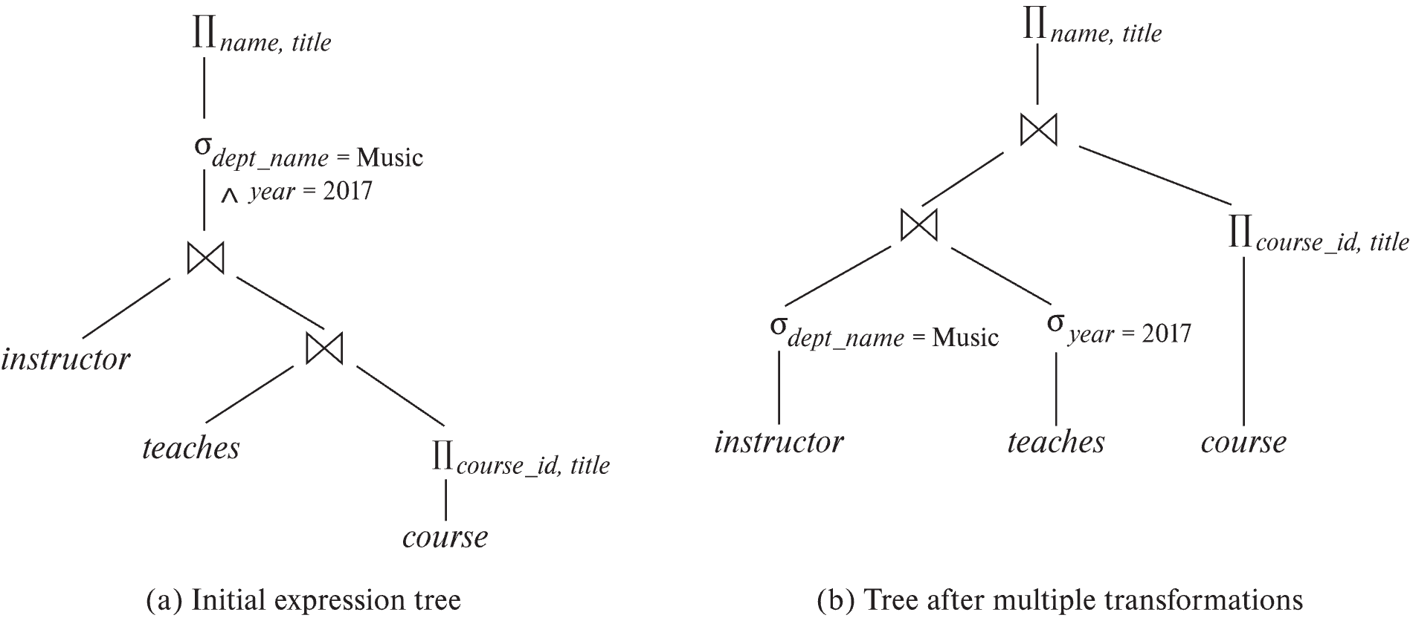
Multiple Transformations (Cont.)

Slide 20
Transformation Example: Pushing Projections
Consider: Π_{name, title}(σ_{dept_name= “Music”} (instructor) ⨝ teaches) ⨝ Π_{course_id, title} (course))))
When we compute
(σ_{dept_name = “Music”} (instructor ⨝ teaches)
we obtain a relation whose schema is: (ID, name, dept_name, salary, course_id, sec_id, semester, year)
Push projections using equivalence rules 8a and 8b; eliminate unneeded attributes from intermediate results to get: Π_{name, title}(Π_{name, course_id} ( σ_{dept_name= “Music”} (instructor) ⨝ teaches)) ⨝ Π_{course_id, title} (course))))
Performing the projection as early as possible reduces the size of the relation to be joined.

Slide 21
Join Ordering Example
For all relations r_{1,} r_{2,} and r₃,
(r₁ ⨝ r₂) ⨝ r₃ = r₁ ⨝ (r₂ ⨝ r₃ )
(Join Associativity) ⨝
If r₂ ⨝ r₃ is quite large and r₁ ⨝ r₂ is small, we choose
(r₁ ⨝ r₂) ⨝ r₃
so that we compute and store a smaller temporary relation.

Slide 22
Join Ordering Example (Cont.)
Consider the expression
Π_{name, title}(σ_{dept_name= “Music”} (instructor) ⨝ teaches) ⨝ Π_{course_id, title} (course))))
Could compute teaches ⨝ Π_{course_id, title} (course) first, and join result with σ_{dept_name= “Music”} (instructor) but the result of the first join is likely to be a large relation.
Only a small fraction of the university’s instructors are likely to be from the Music department
it is better to compute
σ_{dept_name= “Music”} (instructor) ⨝ teaches
first.

Slide 23
Cost Estimation
Cost of each operator computer as described in Chapter 15
Need statistics of input relations
E.g., number of tuples, sizes of tuples
Inputs can be results of sub-expressions
Need to estimate statistics of expression results
To do so, we require additional statistics
E.g., number of distinct values for an attribute
More on cost estimation later

Slide 24
Choice of Evaluation Plans
Must consider the interaction of evaluation techniques when choosing evaluation plans
choosing the cheapest algorithm for each operation independently may not yield best overall algorithm. E.g.
merge-join may be costlier than hash-join, but may provide a sorted output which reduces the cost for an outer level aggregation.
nested-loop join may provide opportunity for pipelining
Practical query optimizers incorporate elements of the following two broad approaches:
1. Search all the plans and choose the best plan in a cost-based fashion.
2. Uses heuristics to choose a plan.

Slide 25
Cost-Based Optimization
Consider finding the best join-order for r₁ ⨝ r₂ ⨝ . . . ⨝ r_{n}.
There are (2(n – 1))!/(n – 1)! different join orders for above expression. With n = 7, the number is 665280, with n = 10, the number is greater than 176 billion!
No need to generate all the join orders. Using dynamic programming, the least-cost join order for any subset of {r₁, r₂, . . . r_{n}} is computed only once and stored for future use.

Slide 26
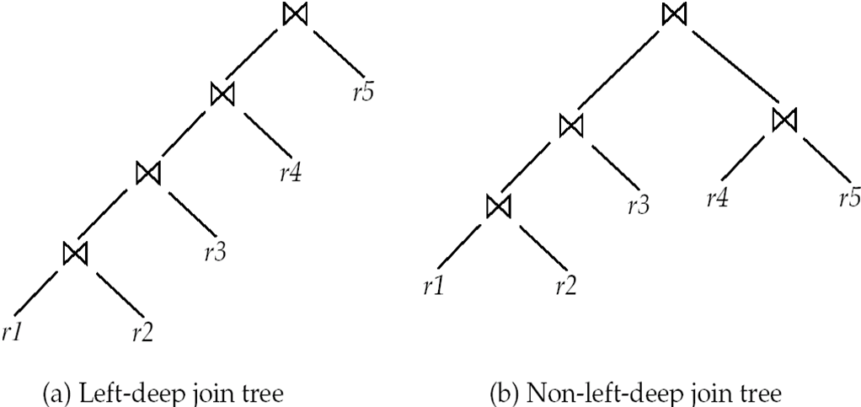
Left Deep Join Trees
In left-deep join trees, the right-hand-side input for each join is a relation, not the result of an intermediate join.

Slide 27
Heuristic Optimization
Cost-based optimization is expensive, even with dynamic programming.
Systems may use heuristics to reduce the number of choices that must be made in a cost-based fashion.
Heuristic optimization transforms the query-tree by using a set of rules that typically (but not in all cases) improve execution performance:
Perform selection early (reduces the number of tuples)
Perform projection early (reduces the number of attributes)
Perform most restrictive selection and join operations (i.e., with smallest result size) before other similar operations.
Some systems use only heuristics, others combine heuristics with partial cost-based optimization.

Slide 28
Statistics for Cost Estimation

Slide 29
Statistical Information for Cost Estimation
n_{r}: number of tuples in a relation r.
b_{r}: number of blocks containing tuples of r.
l_{r}: size of a tuple of r.
f_{r}: blocking factor of r — i.e., the number of tuples of r that fit into one block.
V(A, r): number of distinct values that appear in r for attribute A; same as the size of ∏_{A}(r).
If tuples of r are stored together physically in a file, then:

Slide 30
Histograms
Histogram on attribute age of relation person
Equi-width histograms
Equi-depth histograms break up range such that each range has (approximately) the same number of tuples
E.g. (4, 8, 14, 19)
Many databases also store n most-frequent values and their counts
Histogram is built on remaining values only

Slide 31
Histograms (cont.)
Histograms and other statistics usually computed based on a random sample
Statistics may be out of date
Some database require a analyze command to be executed to update statistics
Others automatically recompute statistics
e.g., when number of tuples in a relation changes by some percentage

Slide 32
Selection Size Estimation
σ_{A=v}(r)
n_{r} / V(A,r) : number of records that will satisfy the selection
Equality condition on a key attribute: size estimate = 1
σ_{A≤V}(r) (case of σ_{A ≥ V}(r) is symmetric)
Let c denote the estimated number of tuples satisfying the condition.
If min(A,r) and max(A,r) are available in catalog
c = 0 if v < min(A,r)
c =
If histograms available, can refine above estimate
In absence of statistical information c is assumed to be n_{r} / 2.

Slide 33
Size Estimation of Complex Selections
The selectivity of a condition θ_{i} is the probability that a tuple in the relation r satisfies θ_{i} .
If s_{i} is the number of satisfying tuples in r, the selectivity of θ_{i} is given by s_{i} /n_{r}.
Conjunction: σ_{θ1∧ θ2∧. . . ∧ θn} (r). Assuming independence, estimate of tuples in the result is:
Disjunction:σ_{θ1∨} _{θ2 ∨. . . ∨} _{θn} (r). Estimated number of tuples:
Negation: σ_{¬θ}(r). Estimated number of tuples: n_{r} – size(σ_{θ}(r))

Slide 34
Join Operation: Running Example
Running example: student ⨝ takes
Catalog information for join examples:
n_{student} = 5,000.
f_{student} = 50, which implies that b_{student} =5000/50 = 100.
n_{takes} = 10000.
f_{takes} = 25, which implies that b_{takes} = 10000/25 = 400.
V(ID, takes) = 2500, which implies that on average, each student who has taken a course has taken 4 courses.
Attribute ID in takes is a foreign key referencing student.
V(ID, student) = 5000 (primary key!)

Slide 35
Additional Optimization techniques

Slide 36
Optimizing Nested Subqueries**
Nested query example: select name from instructor where exists (select * from teaches where instructor.ID = teaches.ID and teaches.year = 2019)
SQL conceptually treats nested subqueries in the where clause as functions that take parameters and return a single value or set of values
Parameters are variables from outer level query that are used in the nested subquery; such variables are called correlation variables
Conceptually, nested subquery is executed once for each tuple in the cross-product generated by the outer level from clause
Such evaluation is called correlated evaluation
Note: other conditions in where clause may be used to compute a join (instead of a cross-product) before executing the nested subquery

Slide 37
Optimizing Nested Subqueries (Cont.)
Correlated evaluation may be quite inefficient since
a large number of calls may be made to the nested query
there may be unnecessary random I/O as a result
SQL optimizers attempt to transform nested subqueries to joins where possible, enabling use of efficient join techniques
E.g.,: earlier nested query can be rewritten as ∏ _{name}(instructor ⨝instructor.ID=teaches.ID ∧ teaches.year=2019 teaches)
Note: the two queries generate different numbers of duplicates (why?)
Can be modified to handle duplicates correctly using semijoins

Slide 38
Optimizing Nested Subqueries (Cont.)
The semijoin operator ⋉ is defined as follows
A tuple r_{i} appears n times in r ⋉ _{θ} s if it appears n times in r, and there is at least one matching tuple s_{i} in s
E.g.: earlier nested query can be rewritten as ∏ _{name}(instructor ⋉ instructor.ID=teaches.ID ∧ teaches.year=2019 teaches)
Or even as: ∏_{name}(instructor ⋉_{instructor.ID=teaches.ID} (σ_{teaches.year=2019} teaches))
Now the duplicate count is correct!
The above relational algebra query is also equivalent to from instructor where ID in (select teaches.ID from teaches where teaches.year = 2019)

Slide 39
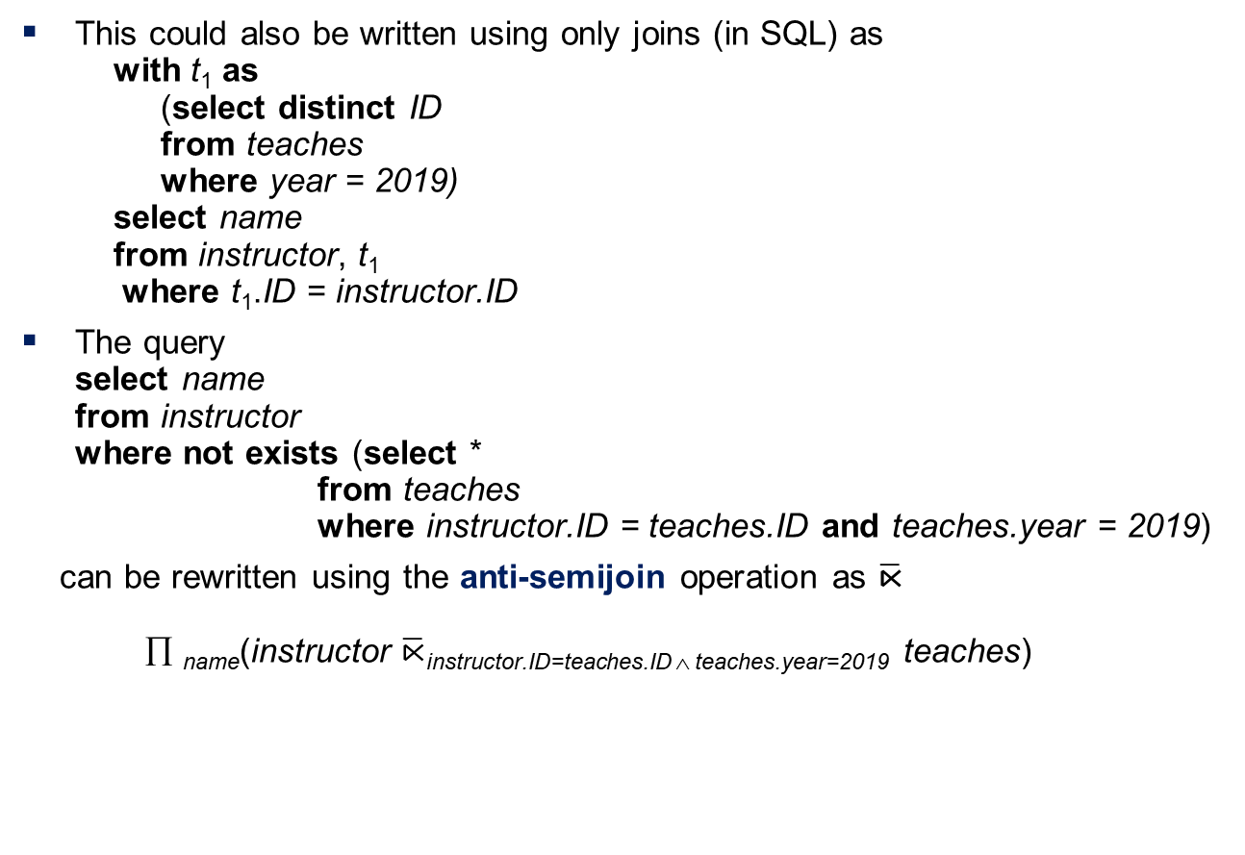
Optimizing Nested Subqueries (Cont.)
This could also be written using only joins (in SQL) as with t₁ as (select distinct ID from teaches where year = 2019) select name from instructor, t₁ where t₁.ID = instructor.ID
The query select name from instructor where not exists (select * from teaches where instructor.ID = teaches.ID and teaches.year = 2019)
can be rewritten using the anti-semijoin operation as $\overline{\text{⋉}}$ ∏ _{name}(instructor $\overline{\text{⋉}}$instructor.ID=teaches.ID ∧ teaches.year=2019 teaches)

Slide 40
Optimizing Nested Subqueries (Cont.)
In general, SQL queries of the form below can be rewritten as shown
Rewrite: select A from r₁, r₂ ,…, r_{n} where P₁ and exists (select * from s₁, s₂ ,…, s_{m} where P₂¹ and P₂² )
To: ∏ _{A}(σ _{P1} (r₁ x r₂ x … x r_{n} ) ⋉ _{P22} σ _{P21} (s₁ x s₂ x … x s_{m} )
P₂¹ contains predicates that do not involve any correlation variables
P₂² contains predicates involving correlation variables
The process of replacing a nested query by a query with a join/semijoin (possibly with a temporary relation) is called decorrelation.
Decorrelation is more complicated in several cases, e.g.
The nested subquery uses aggregation, or
The nested subquery is a scalar subquery
Correlated evaluation used in these cases

Slide 41
Decorrelation (Cont.)
Decorrelation of scalar aggregate subqueries can be done using groupby/aggregation in some cases
select name from instructor where 1 < (select count(*) from teaches where instructor.ID = teaches.ID and teaches.year = 2019)
∏ _{name}(instructor ⋉ _{instructor.ID=TID ∧ 1 < cnt} ( _{ID as TID} 𝛾_{count(*) as cnt} (σ _{teaches.year=2019} (teaches))))

Slide 42
Materialized Views
A materialized view is a view whose contents are computed and stored.
Consider the view create view department_total_salary(dept_name, total_salary) as select dept_name, sum(salary) from instructor group by dept_name
Materializing the above view would be very useful if the total salary by department is required frequently
Saves the effort of finding multiple tuples and adding up their amounts

Slide 43
Materialized View Maintenance
The task of keeping a materialized view up-to-date with the underlying data is known as materialized view maintenance
Materialized views can be maintained by recomputation on every update
A better option is to use incremental view maintenance
Changes to database relations are used to compute changes to the materialized view, which is then updated
View maintenance can be done by
Manually defining triggers on insert, delete, and update of each relation in the view definition
Manually written code to update the view whenever database relations are updated
Periodic recomputation (e.g. nightly)
Incremental maintenance supported by many database systems
Avoids manual effort/correctness issues

Slide 44
Incremental View Maintenance
The changes (inserts and deletes) to a relation or expressions are referred to as its differential
Set of tuples inserted to and deleted from r are denoted i_{r} and d_{r}
To simplify our description, we only consider inserts and deletes
We replace updates to a tuple by deletion of the tuple followed by insertion of the update tuple
We describe how to compute the change to the result of each relational operation, given changes to its inputs
We then outline how to handle relational algebra expressions

Slide 45
End of Chapter

Slide 46
Figure 13.01

Slide 47
Figure 13.02

Slide 48
Figure 13.03

Slide 49
Figure 13.04

Slide 50
Figure 13.06

Slide 51
Figure 13.08

